Slide 1
Assignment 3 - Data Analytics Group #A6
Kunal Verma – C0726931
Gurpreet singh- C0727471
Danish sapra- C0726552
Ravindejit Kaur – C0732081
Simrandeep kaur – C0732174
Amandeep singh- C0732090

Slide 2
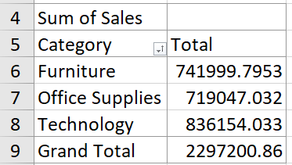
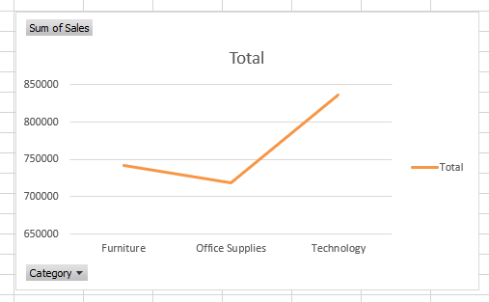
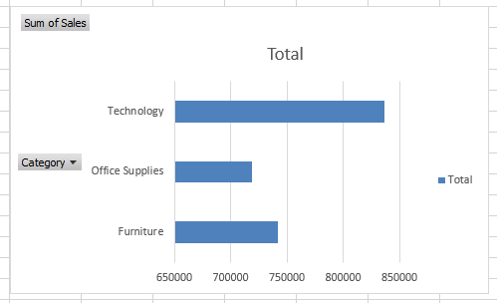
Total Sales per Category to find out most selling category.
In the comparison of category, who have most sales you can see the “FURNITURE” is having an upper hand than the other categories where as the Office Supplies comes at second and Technology comes at the last position.

Slide 3
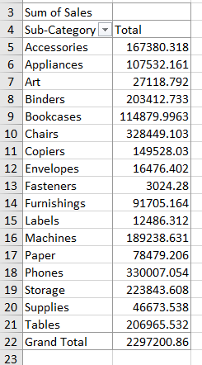
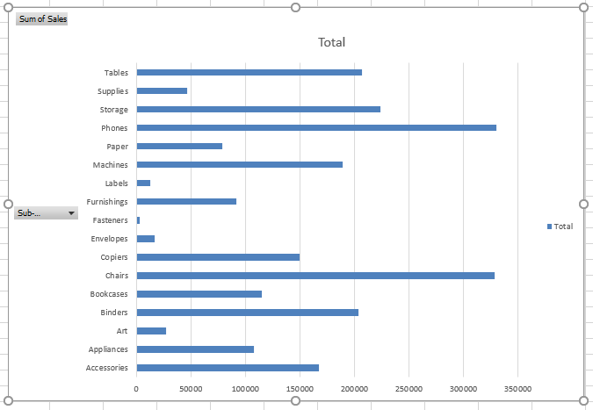
Most sales in a sub category

Slide 4
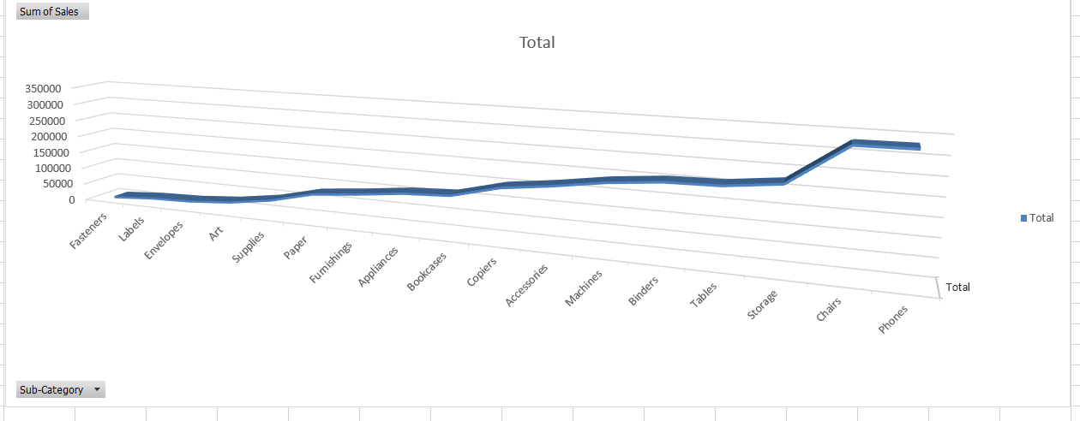
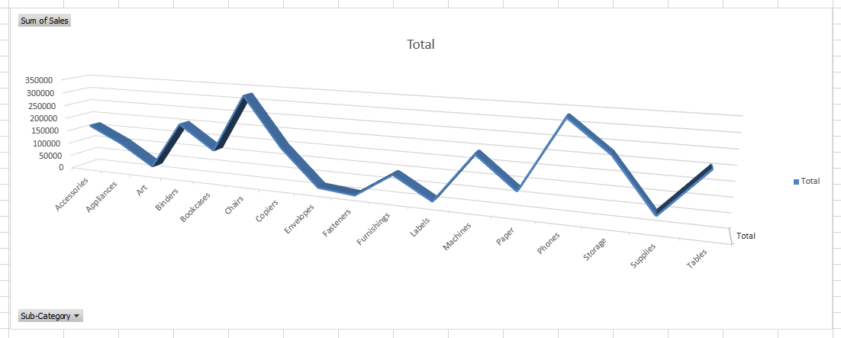
Here we arrange with low to high sales total

Slide 5
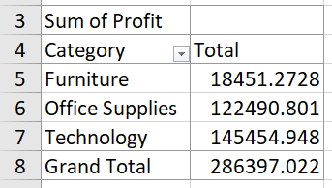
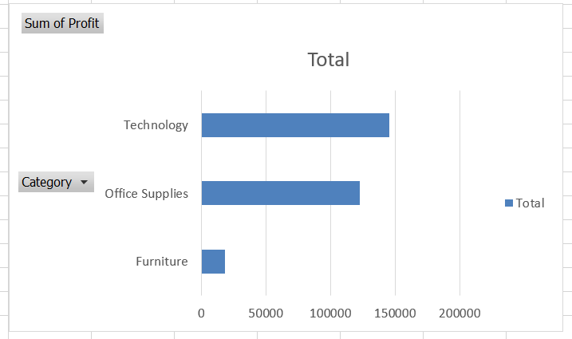
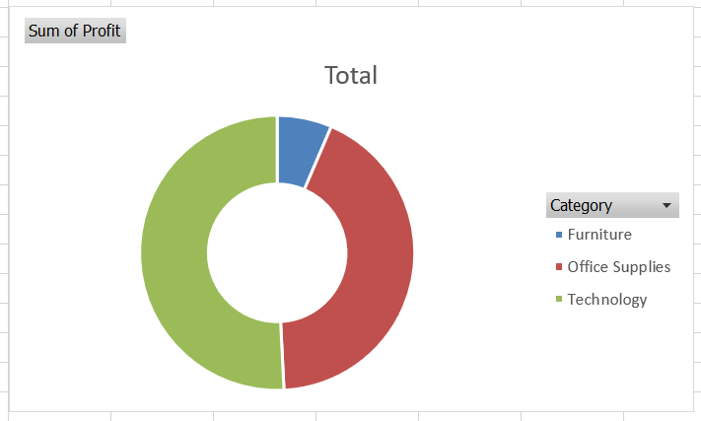
Most profitable category

Slide 6
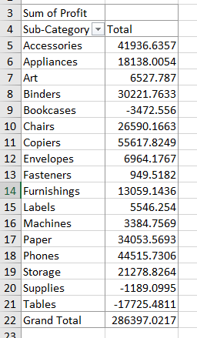
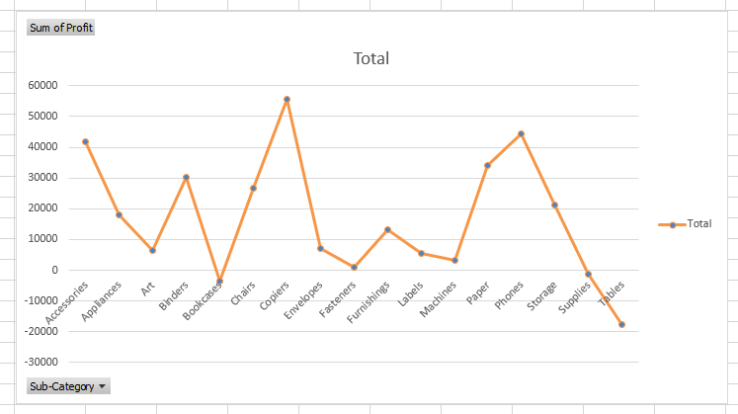
Most profitable sub-category

Slide 7
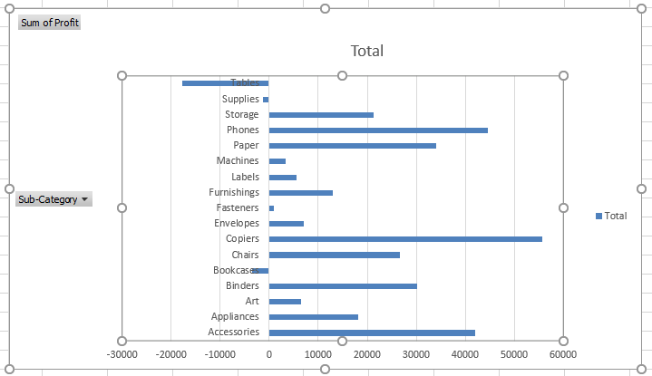

Slide 8
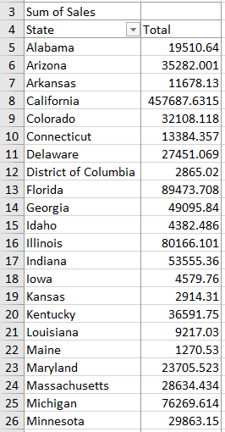
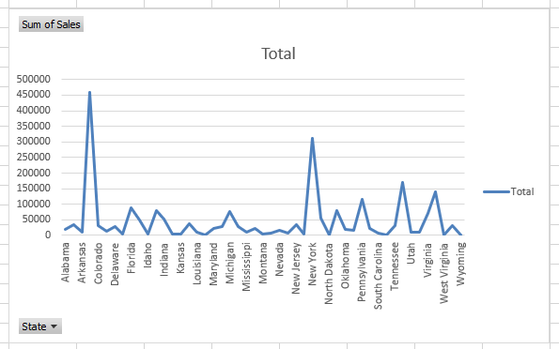
Sales per State

Slide 9
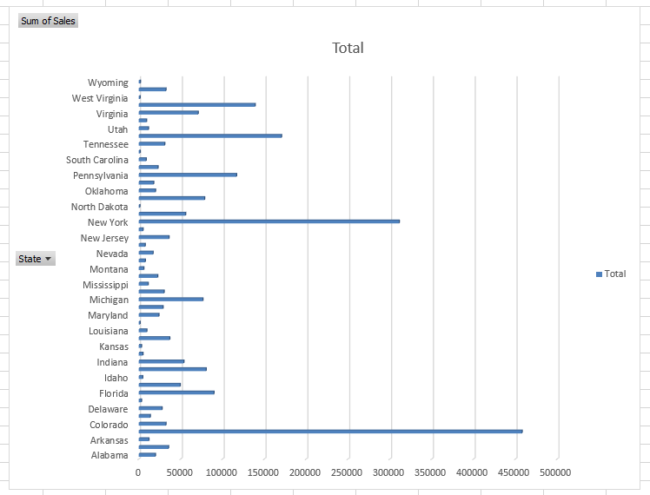
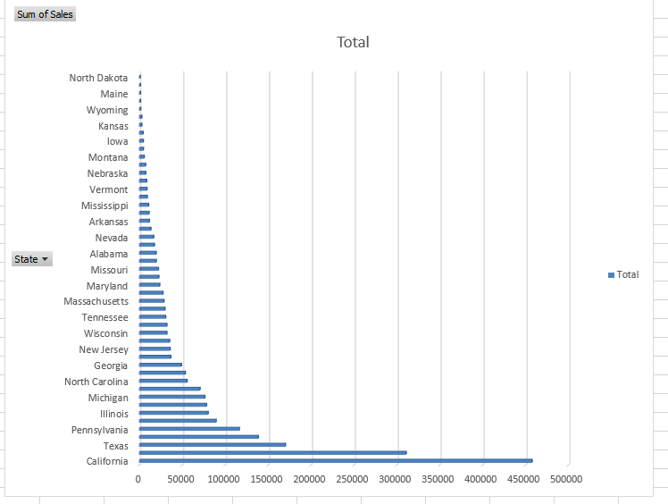
This is data of the Sales done by the different States shown in different charts.
The data represents the sales done by different states.
This data represents the most sales done by states from bottom to top.

Slide 10
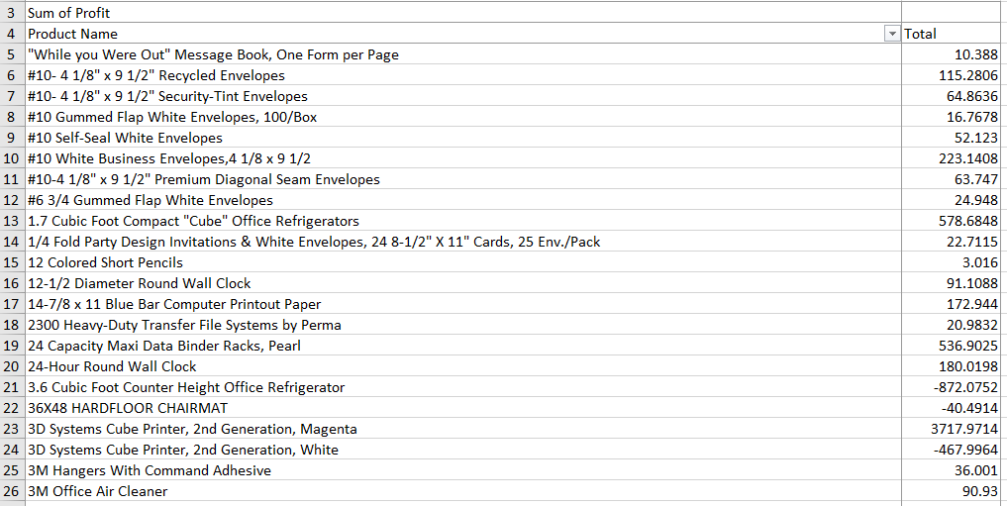
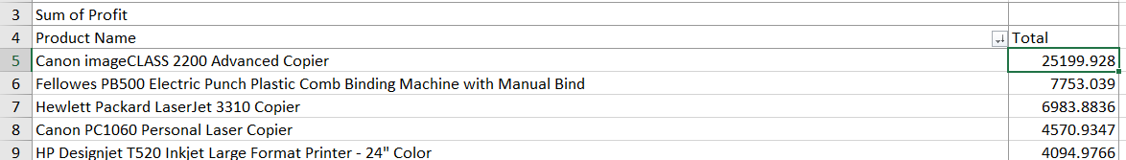
Most profitable
product/ item

Slide 11
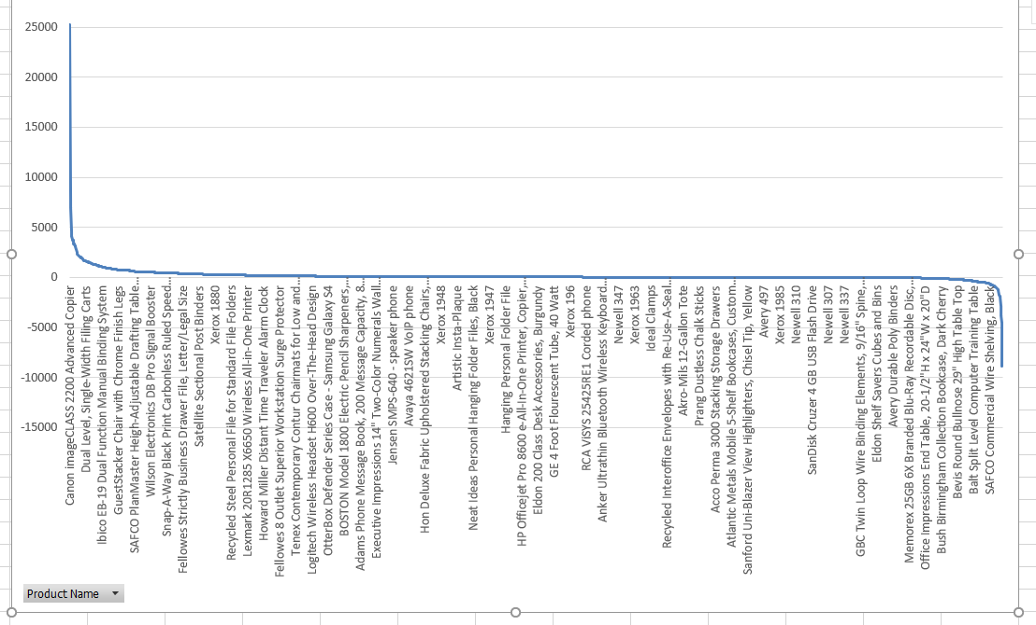

Slide 12
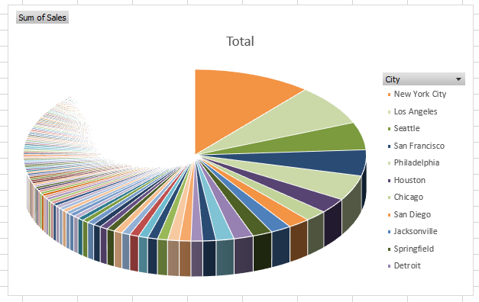
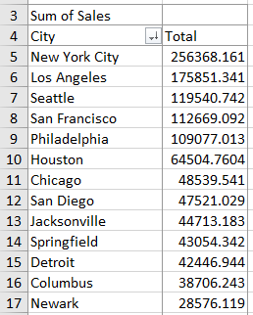
Sales per city
You can see that new York city got more sale.

Slide 13
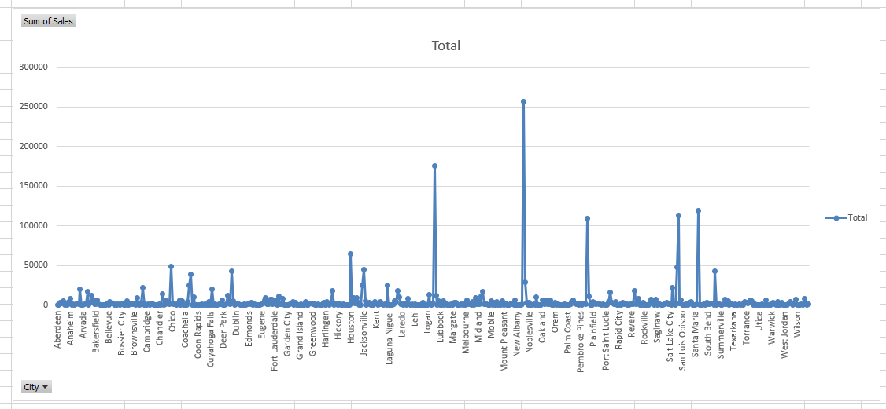

Slide 14
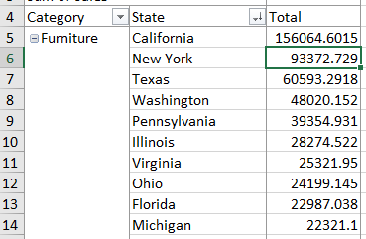
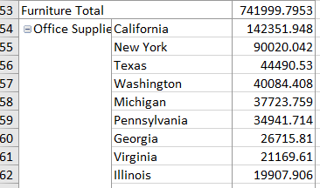
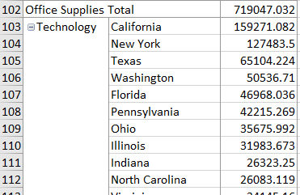

Most Popular category per state
You can see that California got more sale and more popular then the other state

Slide 15
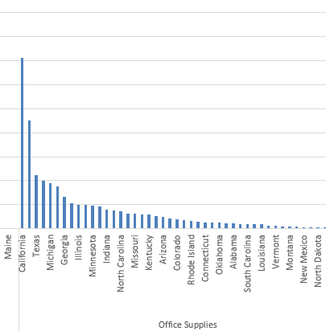
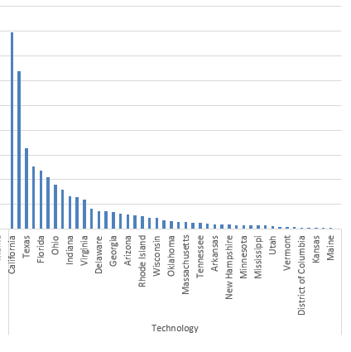
In The Office Supplies California Got More Popular
In technology California Got More Popular

Slide 16
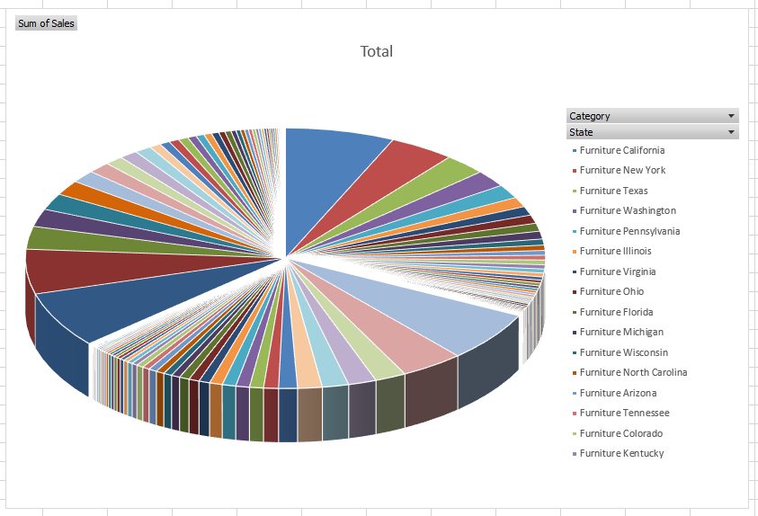
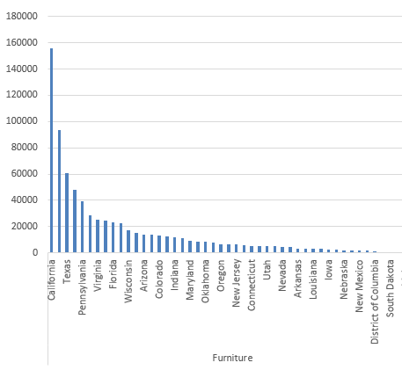

Slide 17
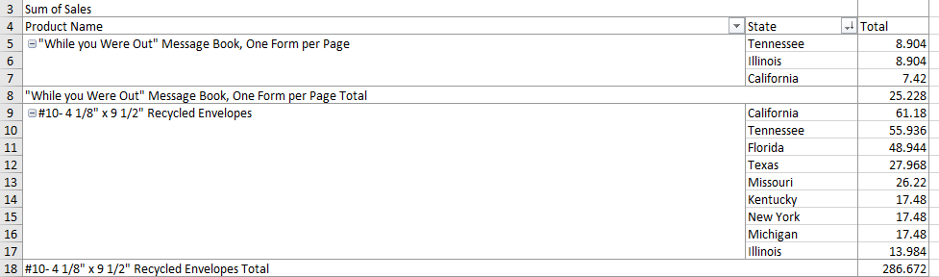
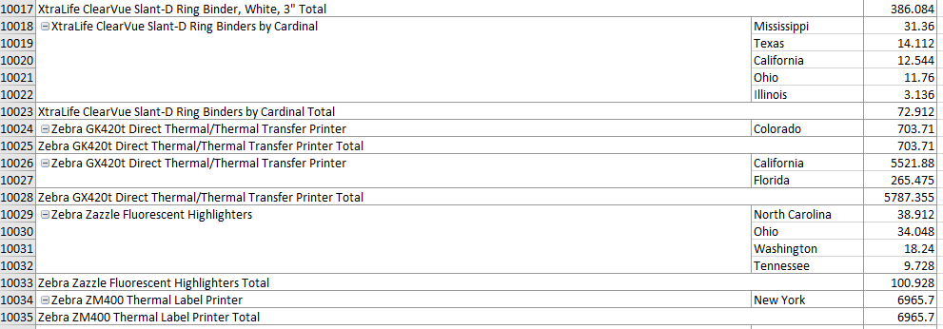
Most profitable
category per state

Slide 18
Now we look in the different Category
Furniture.
Office Supplies.
Technology.

Slide 19
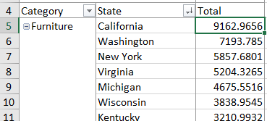
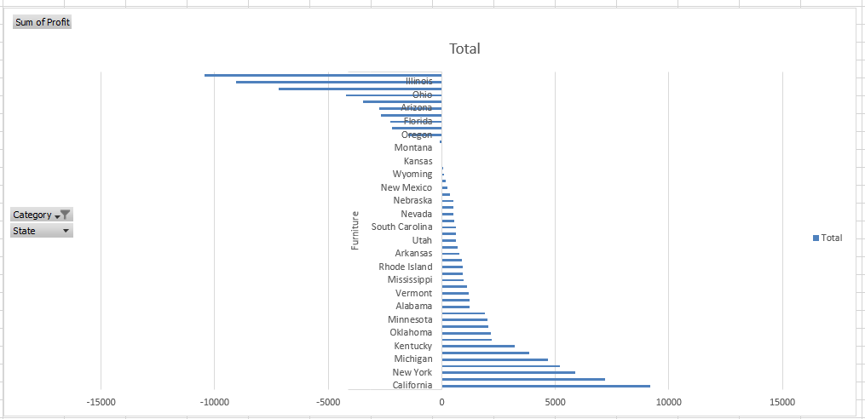
Furniture

Slide 20
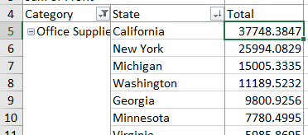
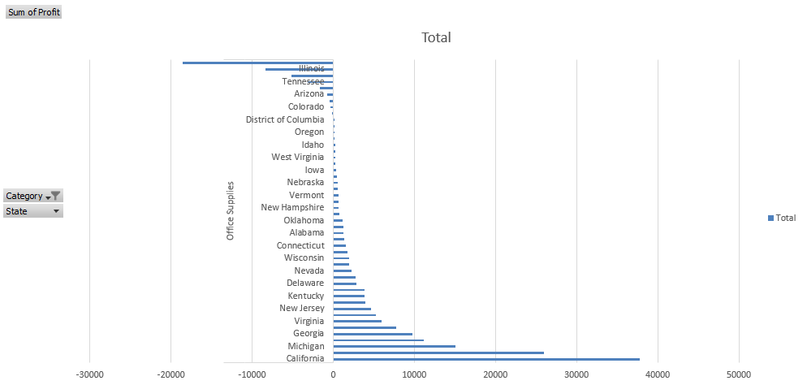
Office Supplies

Slide 21
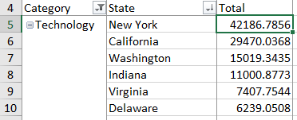
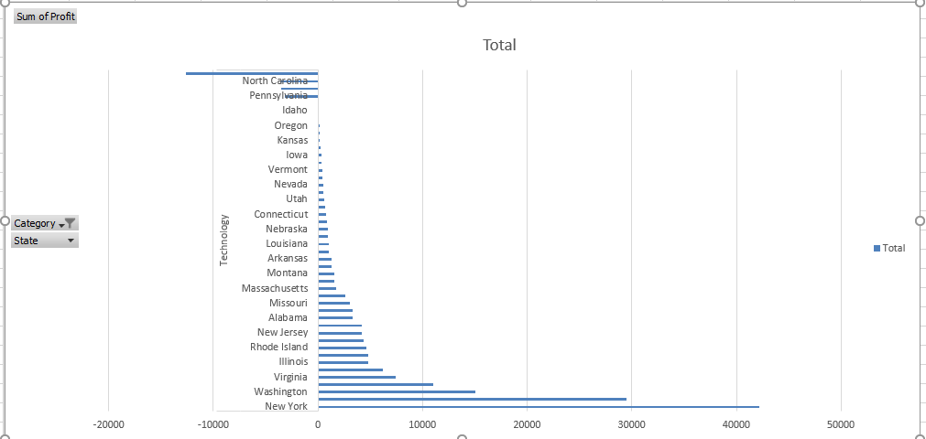
Technology

Slide 22
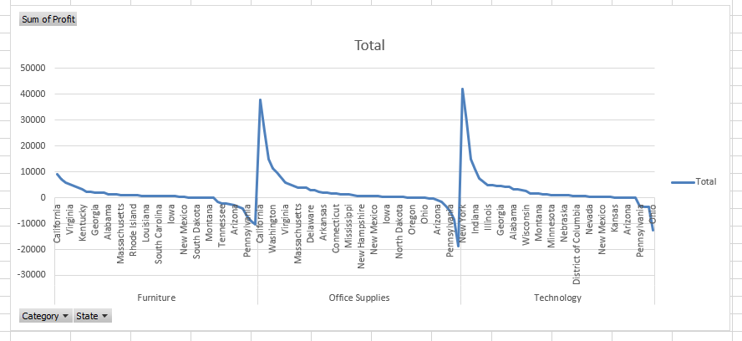
Here we combine the all the category and shows profitable sales done by different state.

Slide 23
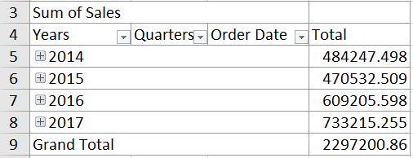
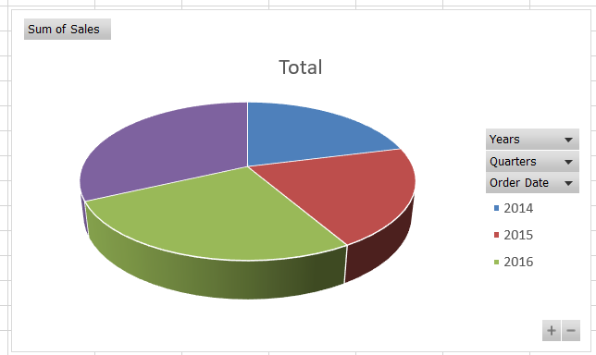
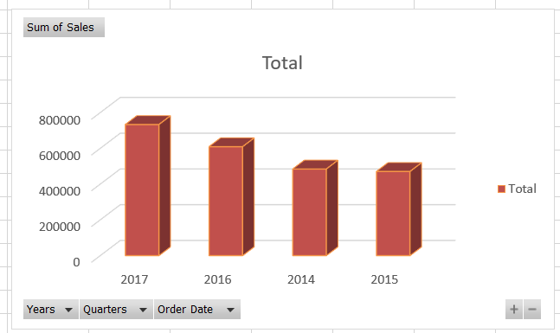
Here we got sales as per done in different years.
2017 is the year which done the highest sales.

Slide 24
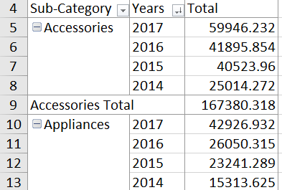
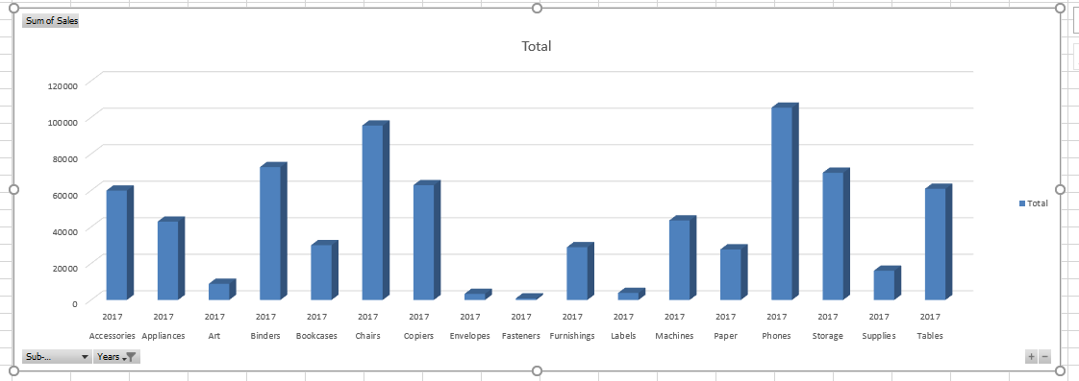
As we have summarized 2017 has highest sales out of which
Phone ranks first over the whole year.

Slide 25

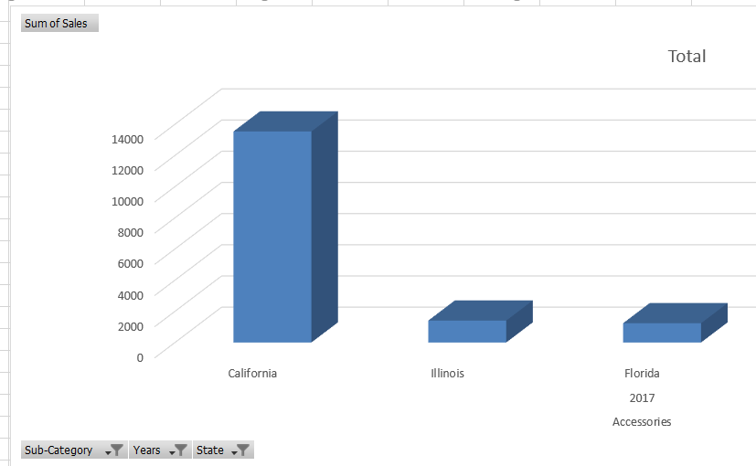
Summary
In the comparison of all the years, we have figured out that 2017 has the highest sale figures.
The Accessory category which ranks top is Phone as compared to all other categories in the year 2017.
California State has the highest sales of the Phones in the most profitable year 2017.
According to our opinion, California should focus more on the sales of phones as the data shows it has recorded the most number of sales of phone in year 2017 and has a higher scope to rise in the upcoming years.

